Slide 1


M.Tech/MCA Program
Advanced Industry Integrated Programs
Jointly offered by University and LTIMindTree
Review III
AI Agent for Health Insurance Claim Assistance
M.Tech
B.S. Abdur Rahman Crescent Institute of Science and Technology/T9961
Team Member
SNEHA SHREE 24
Knowledge partner | Implementation partner

Slide 2
Introduction
AI-based platform designed to simplify the health insurance claim process.
Allows users to submit claim details and supporting medical documents.
Performs automated document verification and policy eligibility checking.
Uses machine learning to identify potentially suspicious claim patterns.
Provides AI-based assistance for claim-related queries and guidance.
Recommends suitable hospitals and doctors based on treatment and location.
Provides claim tracking and status updates through a centralized platform

Slide 3
Objective
Automate major stages of the health insurance claim process.
Reduce manual effort in claim verification and processing.
Verify medical documents and supporting claim information.
Check policy eligibility and treatment coverage.
Identify potential fraudulent or abnormal claims.
Provide personalized hospital and doctor recommendations.
Help users understand their claim status and required actions.
Improve the speed, transparency, and usability of claim assistance.

Slide 4
Module name
Module | Function
User Module | Manages user details and claim access
New Claim Module | Collects and submits new claim information
Document Verification | Verifies uploaded medical documents
Eligibility Checker | Checks policy and treatment eligibility
Fraud Detection | Identifies suspicious claim patterns
AI Claim Assistant | Provides claim-related guidance
Hospital Recommendation | Suggests suitable hospitals
Doctor Recommendation | Suggests doctors based on treatment
Claim Tracking | Tracks claim progress and status
Admin Dashboard | Supports claim monitoring and management

Slide 5
Methodology/Modeling Plan
Data Collection
  Collect claim, policy, patient, hospital, doctor, and treatment data.
Data Preprocessing
  Clean, validate, and standardize the collected data.
Exploratory Data Analysis
  Analyze claim amounts, claim status, treatments, and fraud patterns.
Document Processing
  Extract and process information from medical documents.
Eligibility Analysis
  Compare claim and treatment information with policy requirements.
Fraud Detection
  Analyze claim patterns and identify potential risks

Slide 6
Problem Statement
Health insurance claim processing can be complex and time-consuming.
Manual verification of medical documents requires significant effort.
Users may not clearly understand policy eligibility and coverage.
Large numbers of claims make manual fraud identification difficult.
Patients may have difficulty selecting a suitable hospital or doctor for a treatment.
Claim status information may be scattered across different channels.
Existing systems often handle claim processing, fraud detection, and healthcare recommendations separately.

Slide 7
Approach / Algorithms / Tools
Approach | Algorithms / Techniques | Tools / Technologies
Data Collection | Data Integration | Python
Data Preprocessing | Cleaning & Normalization | Pandas, NumPy
EDA | Statistical Analysis | Matplotlib
Claim Analysis | Classification / Risk Analysis | Scikit-learn
Eligibility Checking | Rule-Based Analysis | Python
Fraud Detection | Machine Learning Classification | Scikit-learn
Document Processing | Text Extraction | PDF/DOCX Processing
Provider Recommendation | Location & Specialty Matching | Python
AI Assistance | RAG | Python
AI Response Generation | LLM | Groq API
Backend | REST API | FastAPI
Frontend | Component-Based UI | React.js
Data Storage | Structured Data Storage | Excel / CSV

Slide 8
Data preprocessing & EDA
Data preprocessing
Remove duplicate and inconsistent records.
Handle missing values in claim data.
Clean and standardize policy and medical information.
Convert categorical data into a suitable format.
Prepare structured data for claim analysis and AI agents.
Normalize claim-related attributes.

Slide 9
Findings and Results
The system can organize claim information into a structured workflow.
Data preprocessing improves the consistency and quality of claim data.
EDA helps identify claim patterns, treatment trends, and unusual records.
Eligibility analysis helps determine whether a claim meets defined policy conditions.
Fraud detection can be used to identify potentially suspicious claims for further review.
Hospital and doctor data can be used to provide treatment-based recommendations.

Slide 10
Project plan/milestones progress
Phase | Activities | Duration
Phase 1 | Requirement Analysis & Project Planning | Week 1
Phase 2 | Dataset Collection & Understanding | Week 2
Phase 3 | Data Preprocessing & EDA | Week 3
Phase 4 | AI Agent Development (Eligibility, Document, Fraud) | Week 4
Phase 5 | Orchestrator Agent & Chatbot Development | Week 5
Phase 6 | Streamlit UI & Database Integration | Week 6
Phase 7 | Testing, Evaluation & Performance Analysis | Week 7
Phase 8 | Deployment, Documentation & Final Presentation | Week 8
Calibri body 28

Slide 11
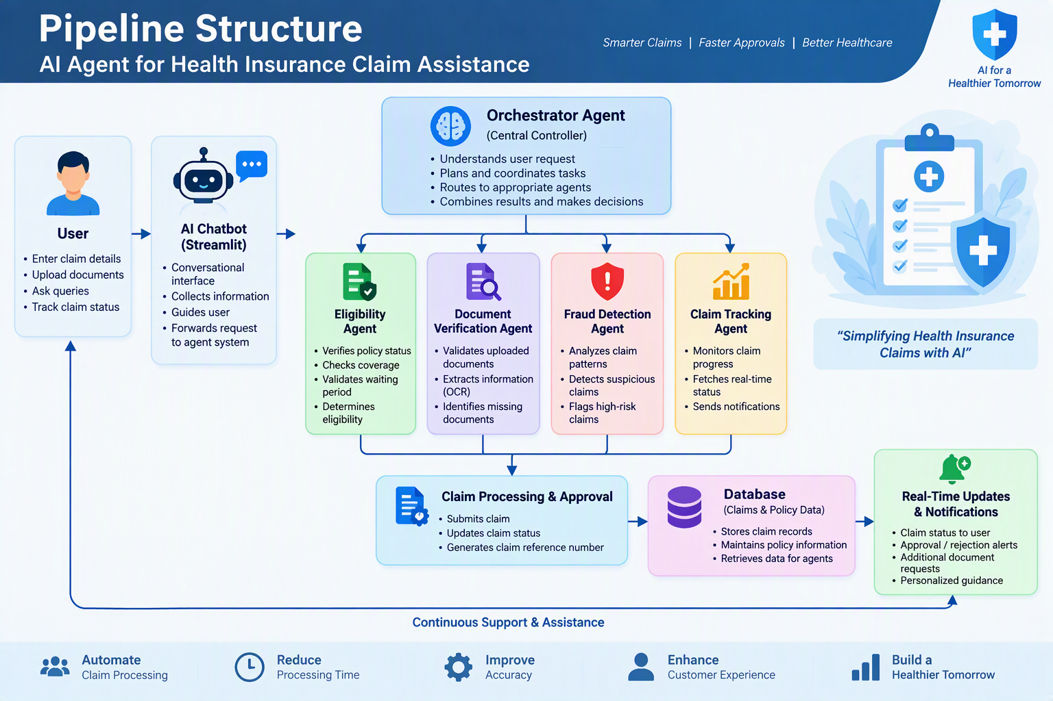
Pipeline structure

Slide 12
Conclusion
The proposed AI-Powered Health Insurance Claim Assistance System integrates claim submission, document verification, eligibility analysis, fraud detection, AI assistance, healthcare provider recommendation, and claim tracking into a single platform. The system aims to reduce manual effort and provide users with faster, clearer, and more accessible claim assistance. The integration of AI and machine learning can further improve the efficiency of insurance claim management while supporting better decision-making.

Slide 13
ACKNOWLEDGEMENT
I sincerely thank LTM and L&T EduTech for providing the necessary infrastructure, laptop, training room, ID card, and the valuable two-month opportunity to enhance my technical skills through practical project development.
I express my special gratitude to Dr. Ganesh for his continuous guidance, valuable suggestions, and support throughout the project. I also extend my sincere thanks to the Classroom Managers for their daily monitoring, coordination, and assistance in resolving various issues.
Finally, I would like to express my special thanks to Mr. Jayakanthan, Manager – Delivery Operations, L&T EduTech, for his encouragement, continuous support, and for providing me with this valuable opportunity to develop my technical and professional skills.

Slide 14
References
Breiman, L. — Random Forests, Machine Learning, 2001.
Pedregosa, F. et al. — Scikit-learn: Machine Learning in Python, Journal of Machine Learning Research, 2011.
McKinney, W. — Python for Data Analysis, O'Reilly Media.
FastAPI Documentation — Backend API development framework.
React Documentation — Frontend application development.
Groq API Documentation — Large Language Model inference.
Relevant health insurance claims datasets used for data analysis and fraud detection.

